Slide 1
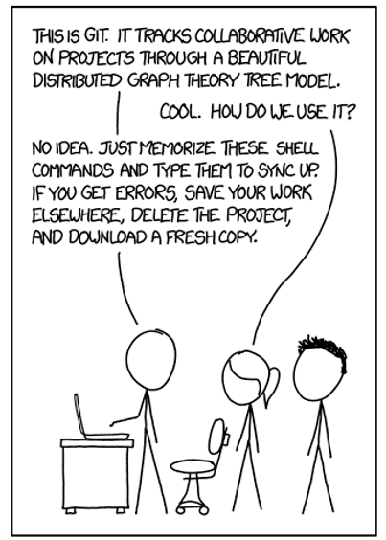

Version Control
Version Control, Git, and GitHub
REM 504-02 Data Science for Natural Resources
Spring 2018
http://xkcd.com

Slide 2
What is version control?
Version control is a system for tracking files over time
Recover work when you mess up
Get back to a specific previous version
Experiment with your work
Make derivations, add new features, etc. without disrupting the main document/file
Collaborate with others
Multiple people can work on a document at the same time
Track and reconcile changes/differences

Slide 3
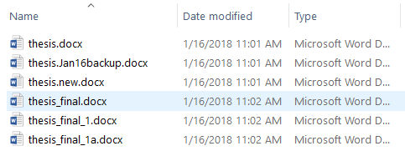
Homegrown Version Control?
You have probably already developed your own type of loose version control
The power of “Save As…”
File organization
File naming conventions

Slide 4
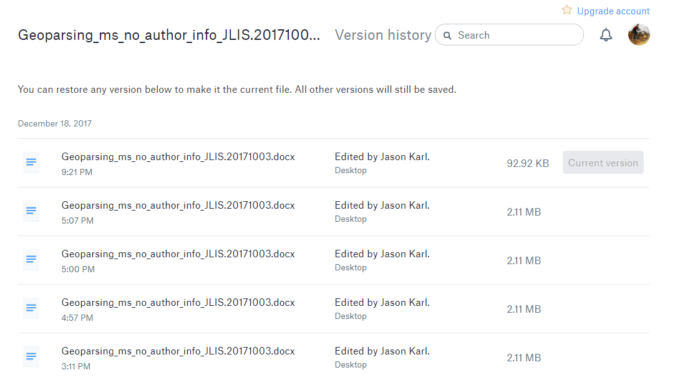
Other examples of version control
AutoRecover in MS Word, Excel, Powerpoint
Dropbox
Google Drive

Slide 5
Features of a good Version Control System (VCS)
Backup/restore
Sharing/collaboration
Synchronization
Track ownership
Track changes
Short-term undo
Long-term undo
“Sandboxing”
Branching-merging
Helpful for giving credit or blamestorming
Isolated area/environment to try out changes or new features.

Slide 6
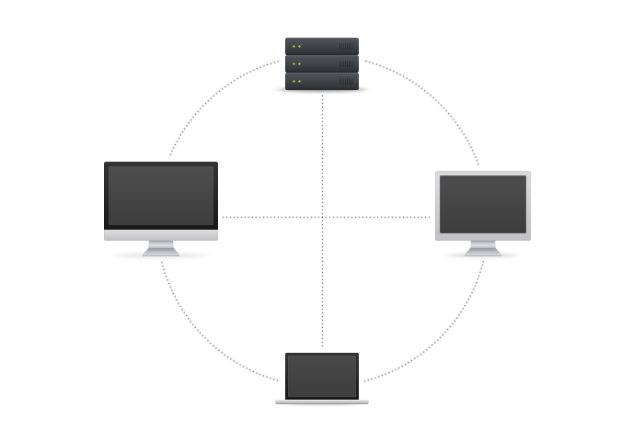
Simple Version Control System (VCS) diagram
VCS Remote Server (e.g., GitHub)
User #1 Local copy
User #2 Local copy
User #3 Local copy
http://guides.beanstalkapp.com/version-control/intro-to-version-control.html

Slide 7
VCS Basic Terms
Repository (Repo, n.) – database storing the files
Working Set/Copy (n.) – local directory of files, where you make changes
Trunk/Main Branch (n.) – primary set of files in the repo
Fork (v.) – clone or make a copy the repo
Commit (v.) – submission of changes to the repo. The VCS tracks changes continually, but waits for you to commit them to the trunk.
Push (v.) – send changes from local repo to remote/server repo.
Pull (v.) – retrieve and new changes from the remote repo and merge them into your local repo.

Slide 8
VCS Basic Terms, Continued
Branch (n., v.) – separate copy of the repo (or portion of it) for private use (testing, bug fixing, new feature dev)
Merge (v.) – combine changes back into the trunk or another branch.
Conflict (n.) – competing changes to a file from different users or different branches. Requires manual intervention to resolve.

Slide 9
Git and GitHub
Git is an open-source distributed VCS
Can run locally as well as on servers
GitHub is a public repository server
Git repo hosting service
Free for public repositories
Other features
Web interface
GitHub Desktop for managing local repos

Slide 10
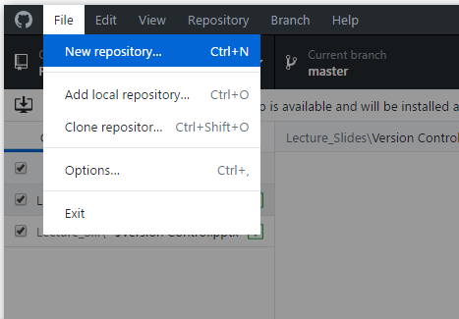
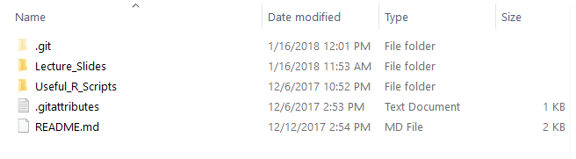
GitHub - Setting up the Local Repo
Markdown Documents are rendered in GitHub https://daringfireball.net/projects/markdown/syntax

Slide 11
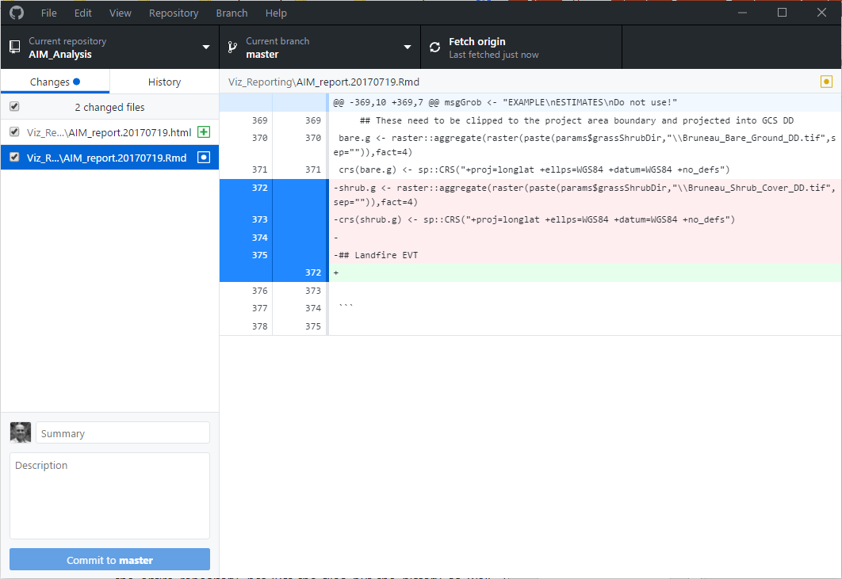
Local View of Repo w/ GitHub Desktop

Slide 12
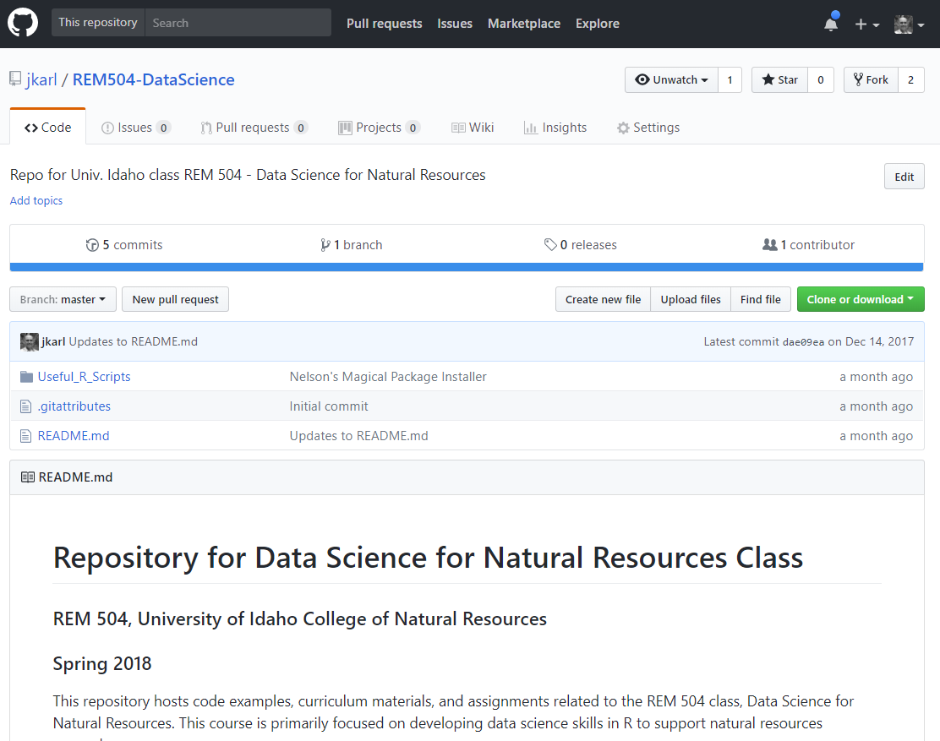
GitHub View of Repo

Slide 13
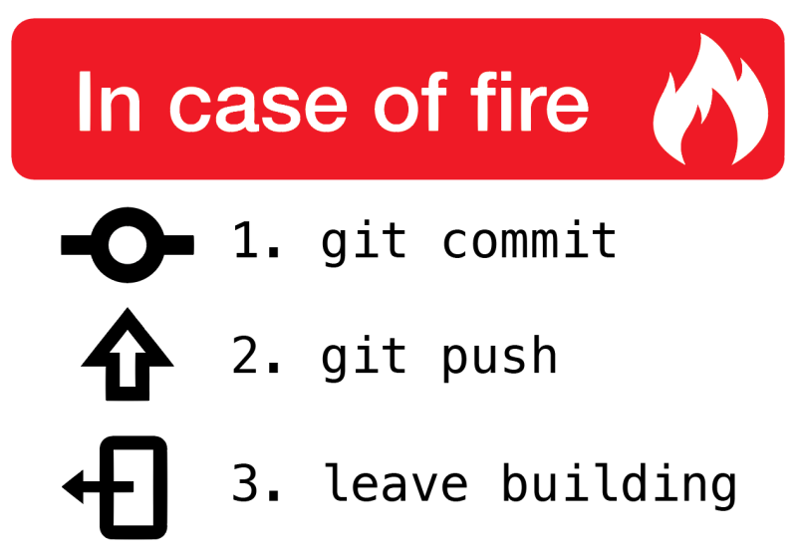
You should be using a real VCS for all analysis & coding projects!

Slide 14
Reasons to (take the time to) use a VCS
Backup/restore ability
More control over when these backups happen
Get away from numbered document versions!!
Use commit summaries/descriptions for documenting changes to analyses/code
i.e., why is each version different?
Provide easy access/distribution for code and analysis products.
Some journals are now requiring code to be placed in a publicly-available repo
Set up isolated environments (branches) for playing around, so you don’t ruin your main code/analyses
Pretty much essential for collaborative coding/analysis projects

Slide 15
GitHub VCS Tips
Start slow
Use initially for posting/distributing/documenting code
Grow into more systematic use to track your work
Don’t worry about features you don’t need.
Don’t make GitHub repos in DropBox or Google Drive folders
File syncing services can corrupt files in the local file repo.
GitHub can be integrated with many coding IDEs
RStudio
WingIDE (python)
Eclipse
?? Others ??

Slide 16
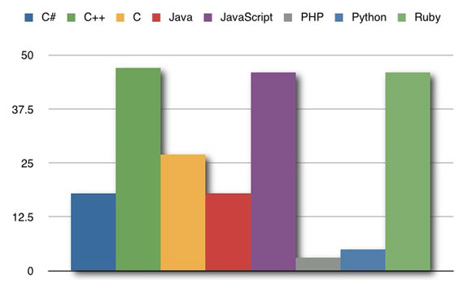
Cursing in GitHub Commits
Swear words per 1000 GitHub Commits
https://www.wired.com/2011/02/cussing-in-commits-which-programming-language-inspires-the-most-swearing/

